Slide 1
Deep Learning (CS324)
2. Mathematical background*
Prof. Jianguo Zhang
SUSTech
*Source: http://www.deeplearningbook.org/lecture_slides.html (2-4) + a bunch of xkcd.com comics
Notes:
In this week, we are going to introduce the basic mathematical concepts needed to understand deep learning. Those knowledge and skills are essential for you to optimize the deep learning models, its cost functions, as well quantify the probability of the output of DL models. The content of this lecture corresponds to the content of Part 1 chapter 2-4. It includes linear algebra, probability, information theory and constrained optimization.

Slide 2
Linear algebra

Slide 3
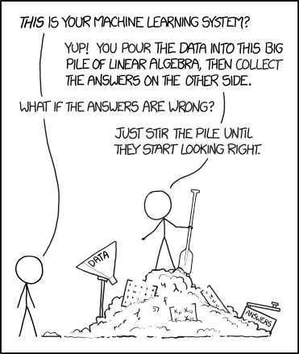
Notes:
Let us have another view of deep learning. From mathematical point of view, this graph shows deep learning could be seen as a pile of linear algebra with lots of data fed into it.. Look this picture, the person on the left asked that is this your machine learning system? Ans: yes, simply feed to data into the model, and the model will predict the correct answer. What if the answers are wrong? Just stir the pile again until the answer looks right. This means linear algebra is fundamental to deep learning. Now let us recap those knowledge.

Slide 4

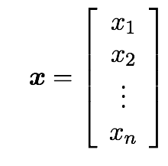
Scalars and vectors
A scalar is a single number
Integers, real numbers, rational numbers, etc.
We denote it with italic font:
A vector is a 1-D array of numbers:
Notes:
The study of linear algebra involves several types of mathematical objects, scalar, vector, matrix and tensor. First, what is a scalar? A scalar is a single number. It could be integers, real numbers, or rational number etc. Normally denoted as italic font. What is a vector? A vector is a 1-D array of numbers. Like this.

Slide 5

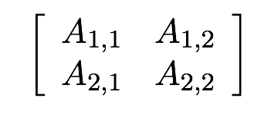
Matrices and tensors
A matrix is a 2-D array of numbers
A tensor is an array of numbers, that may have
zero dimensions, and be a scalar
one dimension, and be a vector
two dimensions, and be a matrix
or more dimensions.

Slide 6
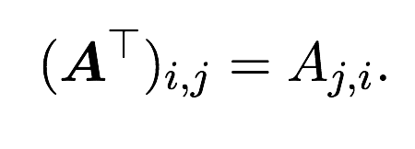
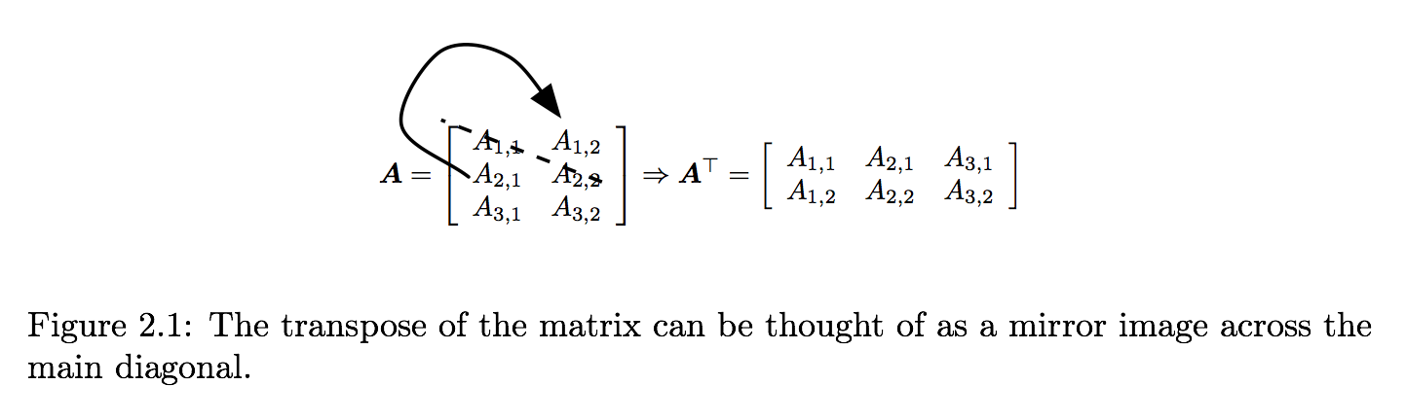
Matrix transpose

Slide 7
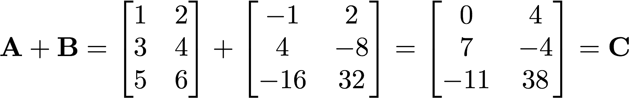
Matrix addition and subtraction
We can add or subtract two matrices A and B only if these have the same size, and the result (for addition) is a matrix C = A + B with elements cij = aij + bij for each 1 ≤ i ≤ m and 1 ≤ j ≤ n

Slide 8
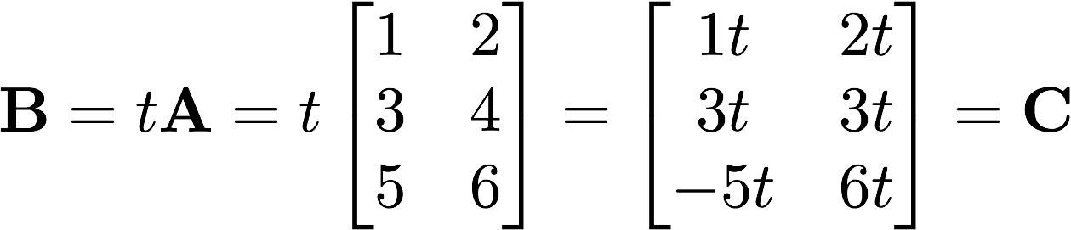
Scalar multiplication
The multiplication of a matrix by a scalar t produces as a result a matrix of the same size whose entries are each multiplied by t

Slide 9
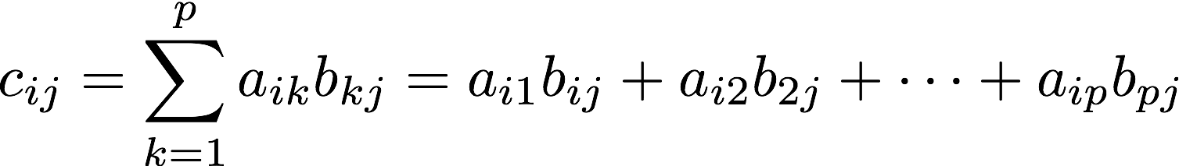
Matrix multiplication
Let A be a m by p matrix and B a q by n matrix: the product AB is defined only when p = q
The elements of C are
n
n
b1j
…
ai1 ai2 ai3 aip
b2j
cij
m
A
q
B
b3j
=
m
C
…
p
bqj

Slide 10
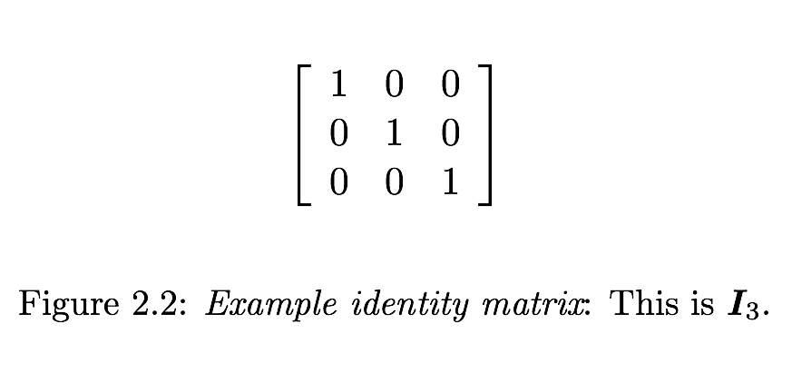


Identity matrix
The identity matrix is the diagonal matrix with ones on the diagonal and zero everywhere else
If A is m x n then

Slide 11
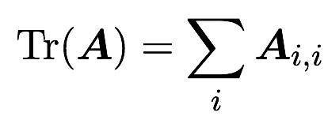
Trace of a matrix
The trace of a matrix is equal to the sum of its diagonal elements

Slide 12
Linear systems of equations
A linear system of equations can have:
No solution
Many solutions
Exactly one solution: if A is invertible

Slide 13
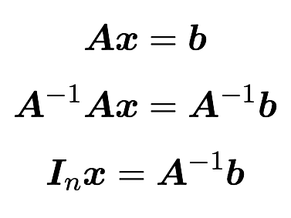
Linear systems of equations
A linear system of equations can have:
No solution
Many solutions
Exactly one solution: if A is invertible

Slide 14
Linear systems of equations
A linear system of equations can have:
No solution
Many solutions
Exactly one solution: if A is invertible
Matrix can’t be inverted if…
More rows/columns than columns/rows
Redundant rows/columns (“linearly dependent”, “low rank”)

Slide 15
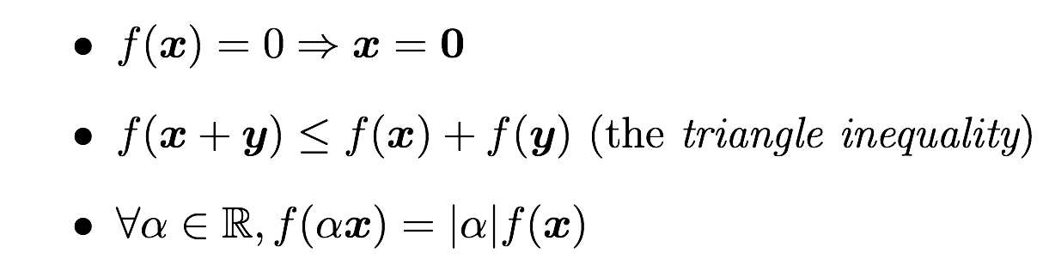
Norms
Functions that measure how “large” a vector is
Similar to a distance between zero and the point represented by the vector

Slide 16
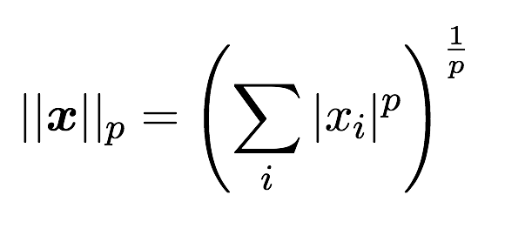
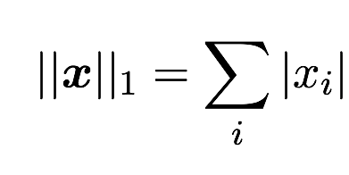
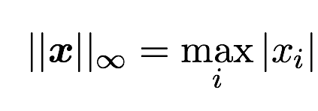
Norms
Lp norms
Most popular norm: L2 norm
L1 norm:
Max norm, infinite p:

Slide 17

Special vectors and matrices
Unit vector:
Symmetric Matrix:
Orthogonal matrix:

Slide 18
Matrix eigendecomposition
Eigenvector and eigenvalue of a square matrix A
Eigendecomposition of a diagonalisable matrix
Every real symmetric matrix has a real, orthogonal eigendecomposition
Notes:
One of the most widely used kinds of matrix decomposition is called eigendecomposition,
in which we decompose a matrix into a set of eigenvectors and
eigenvalues.
An eigenvector of a square matrix A is a non-zero vector v such that multiplication
by A alters only the scale of v:
Av = λv.

Slide 19
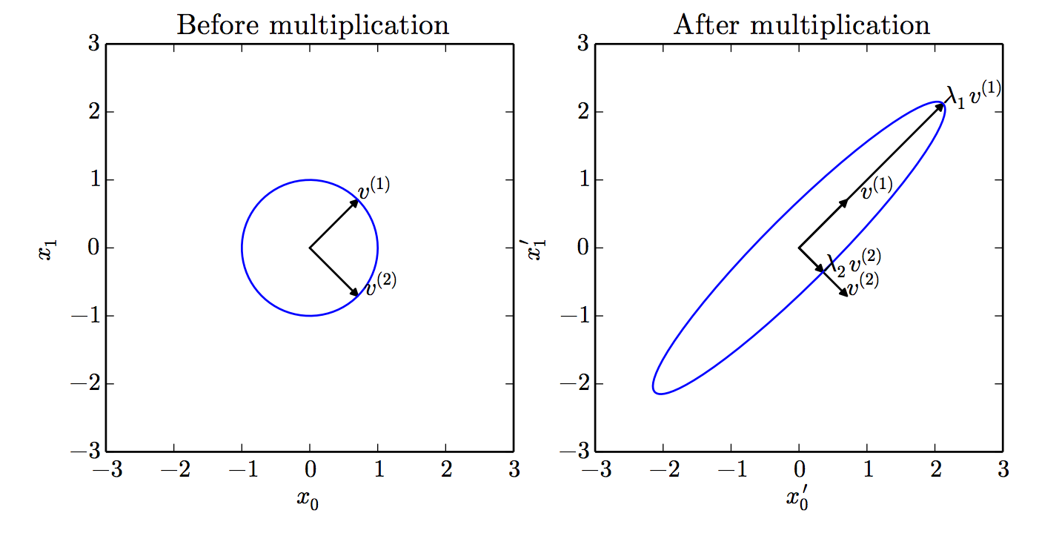
Eigenvalues interpretation
Notes:
An example of the effect of eigenvectors and eigenvalues. Here, we have
a matrix A with two orthonormal eigenvectors, v(1) with eigenvalue λ1 and v (2) with
eigenvalue λ2. (Left)We plot the set of all unit vectors u ∈ R2 as a unit circle. (Right)We
plot the set of all points Au. By observing the way that A distorts the unit circle, we
can see that it scales space in direction v(i) by λi.

Slide 20
Singular value decomposition
What if the matrix A is not square?

Slide 21
Singular value decomposition
What if the matrix A is not square?
More general; matrix need not be square
m x m orthogonal matrix (left-singular vectors - eigenvectors of AA^{T})

Slide 22
Singular value decomposition
What if the matrix A is not square?
More general; matrix need not be square
n x n orthogonal matrix (right-singular vectors - eigenvectors of A^{T}A)

Slide 23
Singular value decomposition
What if the matrix A is not square?
More general; matrix need not be square
m x n diagonal matrix (singular values - square roots of eigenvalues of A^{T}A)

Slide 24
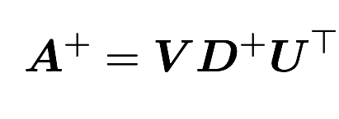
Singular value decomposition
What if the matrix A is not square?
More general; matrix need not be square
Allows to compute Moore-Penrose pseudoinverse

Slide 25
Singular value decomposition
What if the matrix A is not square?
More general; matrix need not be square
Allows to compute Moore-Penrose pseudoinverse
Reciprocal of nonzero elements of D and then transpose
Notes:
The Moore-Penrose pseudoinverse allows us to make some headway in
these cases. The pseudoinverse of A is defined as a matrix
A+ = lim
α0
(AA+ αI)−1A. (2.46)
Practical algorithms for computing the pseudoinverse are not based on this definition,
but rather the formula
A+ = V D+U ,

Slide 26
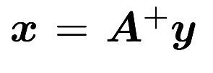
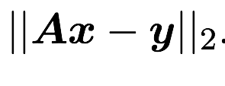
Singular value decomposition
What if the matrix A is not square?
More general; matrix need not be square
Allows to compute Moore-Penrose pseudoinverse
If A has more rows than cols gives solution with min

Slide 27
Probability & information theory

Slide 28
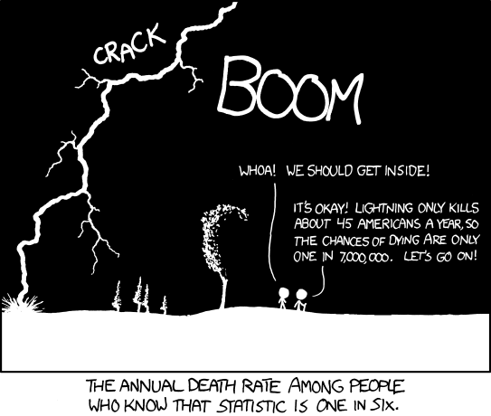

Slide 29
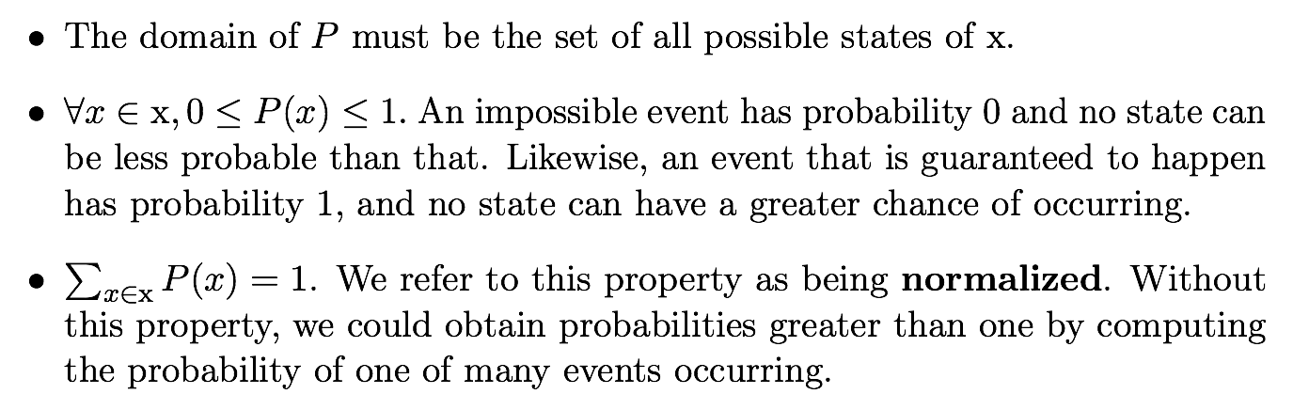
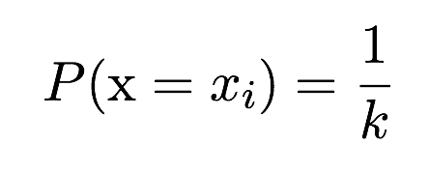
Probability mass function
Example: uniform distribution
Notes:
A probability distribution is a description of how likely a random variable or
set of random variables is to take on each of its possible states. The way we
describe probability distributions depends on whether the variables are discrete or
continuous.

Slide 30
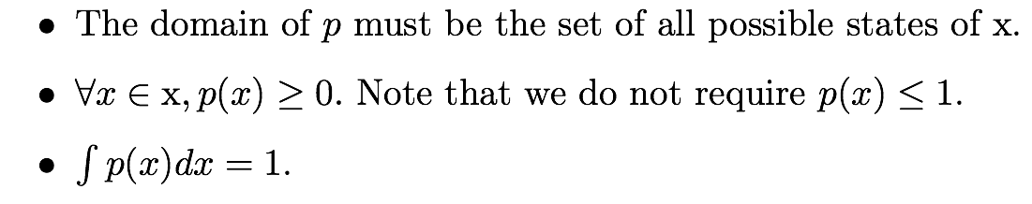
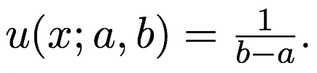
Probability density function
Example: uniform distribution

Slide 31
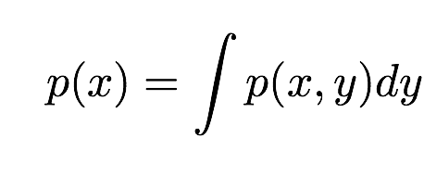
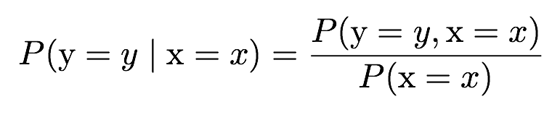
A few important rules…
Marginal probabilities (discrete and continuous)
Conditional probability
Chain rule

Slide 32
A few important rules…
Independence
Conditional independence

Slide 33
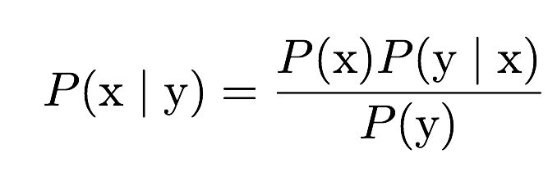
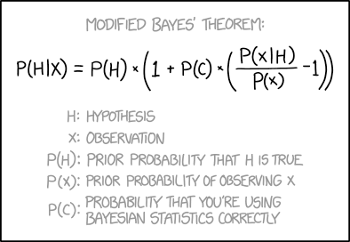
Bayes’ Rule

Slide 34
Bayes’ Rule
NB: I hope there’s no need to point this out but this is just a joke…

Slide 35
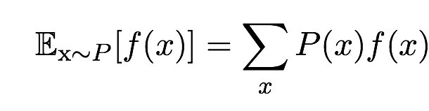
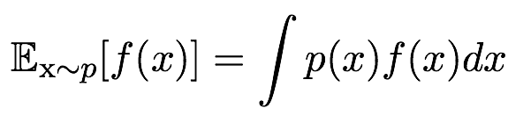
Expectation
of a discrete random variable
of a continuous random variable
Linearity of expectations

Slide 36
Variance and covariance
Variance
Covariance
Covariance matrix given a random vector x

Slide 37
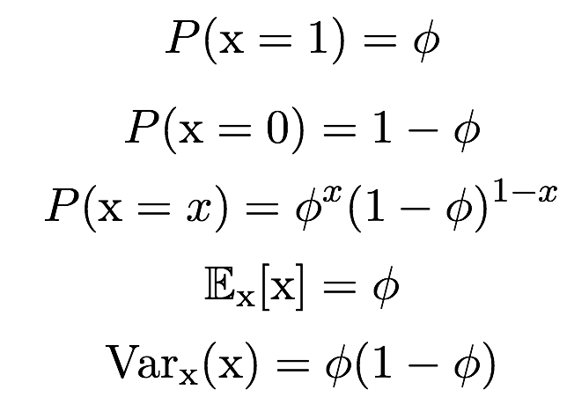
Bernoulli distribution

Slide 38
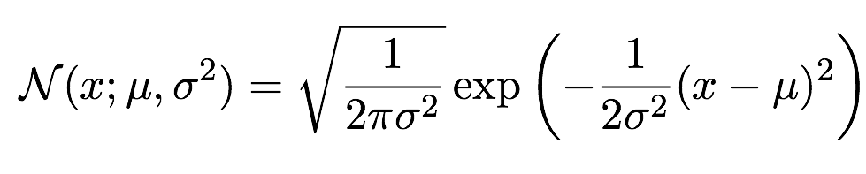
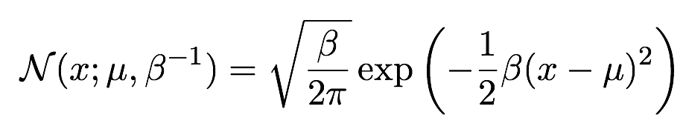
Gaussian distribution
Parametrised by variance
Parametrised by precision

Slide 39
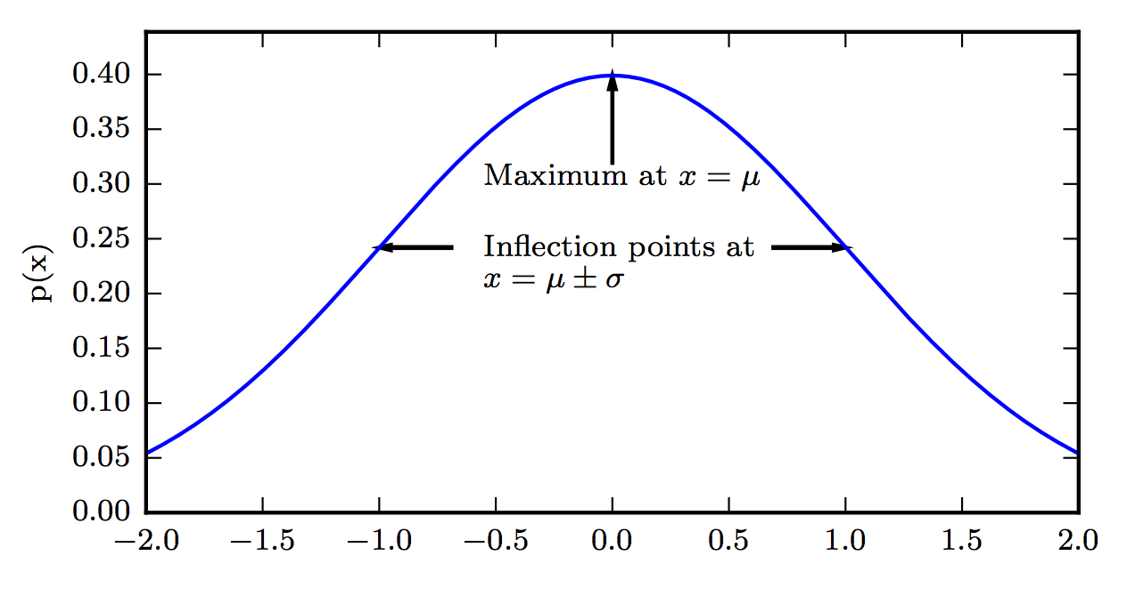
Gaussian distribution
Figure 3.1

Slide 40
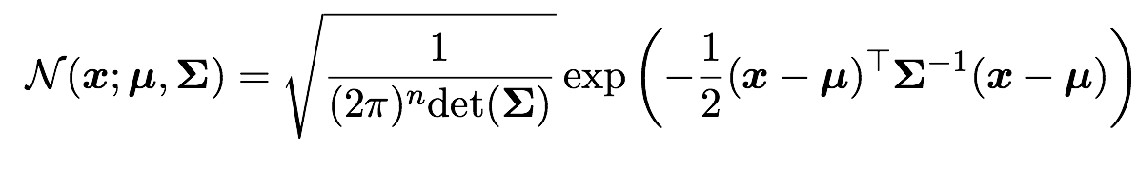
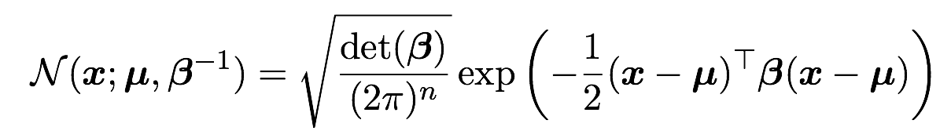
Multivariate Gaussian
Parametrised by variance
Parametrised by precision

Slide 41
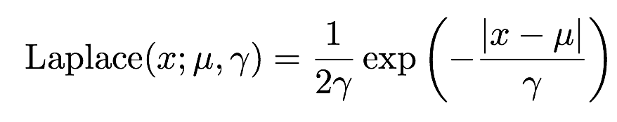
More distributions
Exponential
Laplacian
Dirac
Notes:
In the context of deep learning, we often want to have a probability distribution
with a sharp point at x = 0. To accomplish this, we can use the exponential
distribution:
p(x; λ) = λ1x≥0 exp (−λx) . (3.25)
The exponential distribution uses the indicator function 1x≥0 to assign probability
zero to all negative values of x.
A closely related probability distribution that allows us to place a sharp peak
of probability mass at an arbitrary point μ is the Laplace distribution
Laplace(x;μ, γ) =
1
2γ
exp

−| − | x μ
γ

.

Slide 42
More distributions
Exponential
Laplacian
Dirac
Assign probability zero to all negative values of x

Slide 43
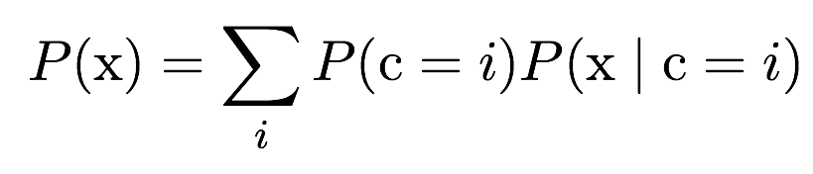
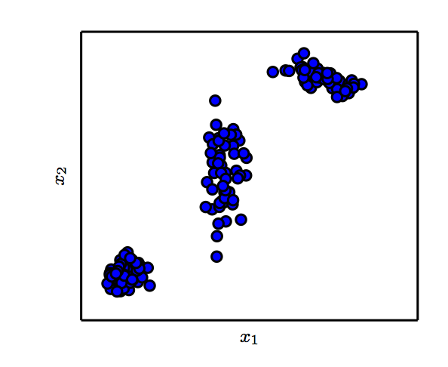
Mixture distributions
Gaussian mixture with three components
Figure 3.2

Slide 44
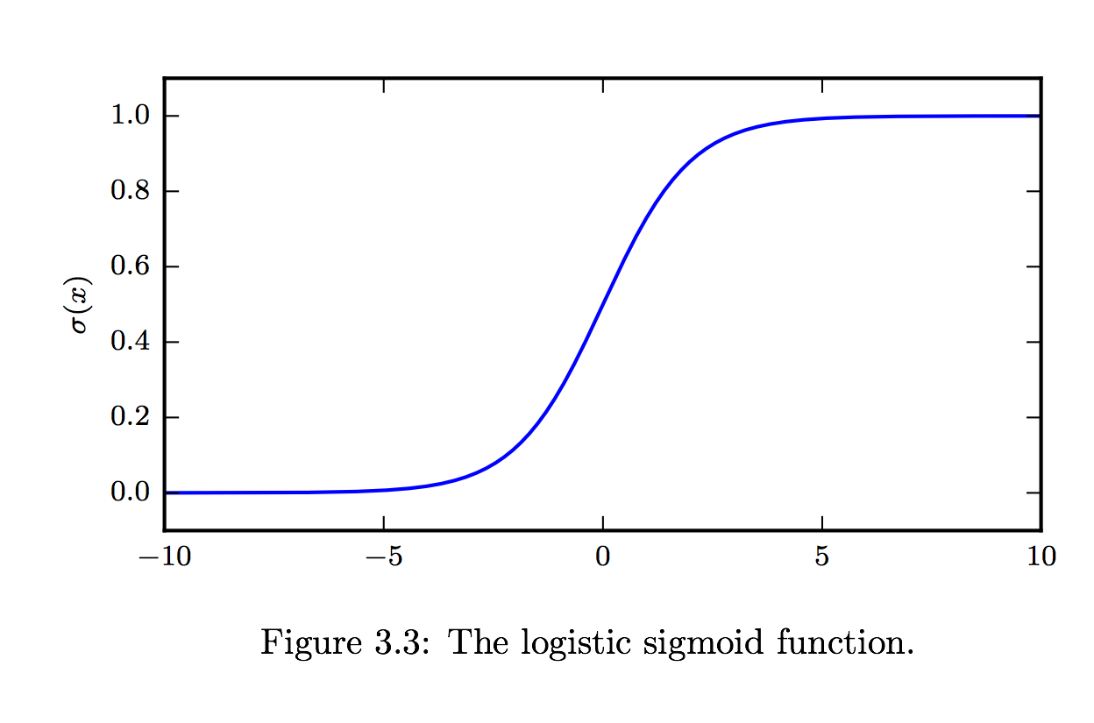
Logistic sigmoid
1/(1+exp(-x))
Commonly used to parametrise Bernoulli distributions

Slide 45
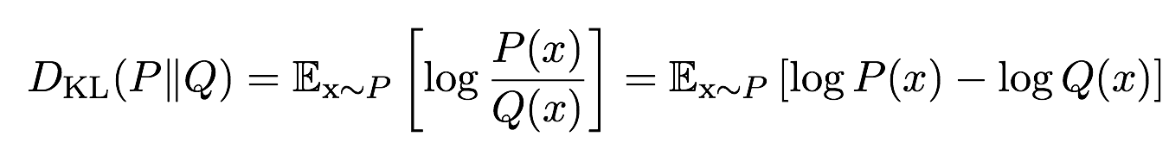
Information theory
Information
Entropy
KL divergence
Notes:
1. The basic intuition behind information theory is that learning that an unlikely event has occurred is more informative than learning that a likely event has
occurred. A message saying “the sun rose this morning” is so uninformative as to be unnecessary to send, but a message saying “there was a solar eclipse this
morning” is very informative.
2. From the definition of information, we can compute the entropy of a variable from its distribution. The entropy measures the flatness of the histogram. If the histogram is flat, then the entropy gets its maximum. If the histogram is not very sharp, for example, the probability of a particular event is 1; then the entropy I zero.
2. Cross entropy is very useful to measure the distance between the two distributions, and it has close relationship with objective function of the maximum likelihood function.

Slide 46
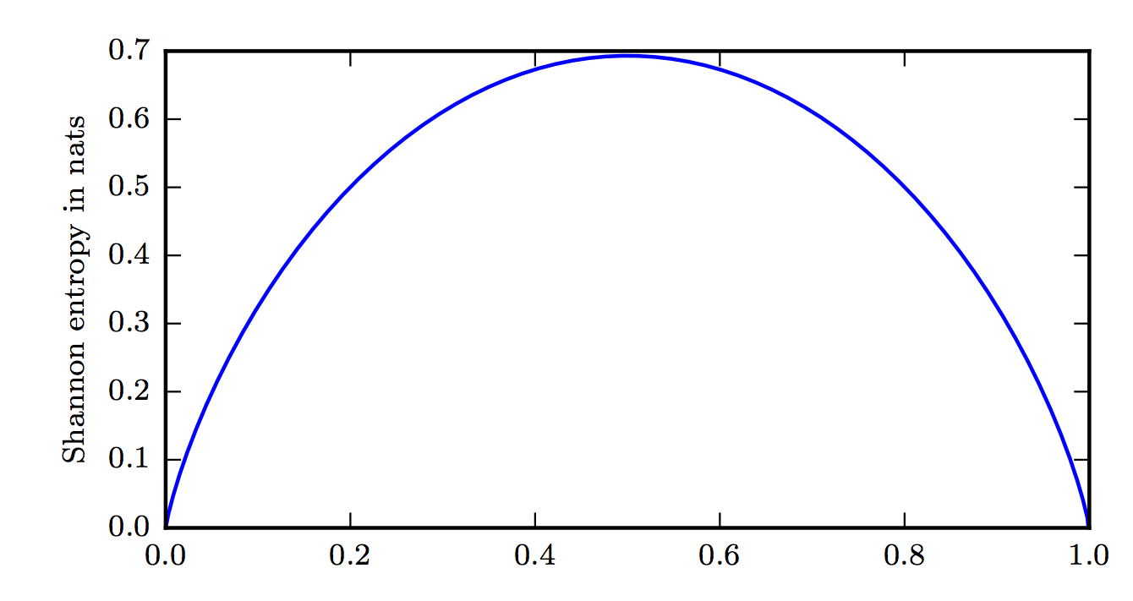
Entropy of a Bernoulli variable
Bernoulli parameter
Figure 3.5

Slide 47
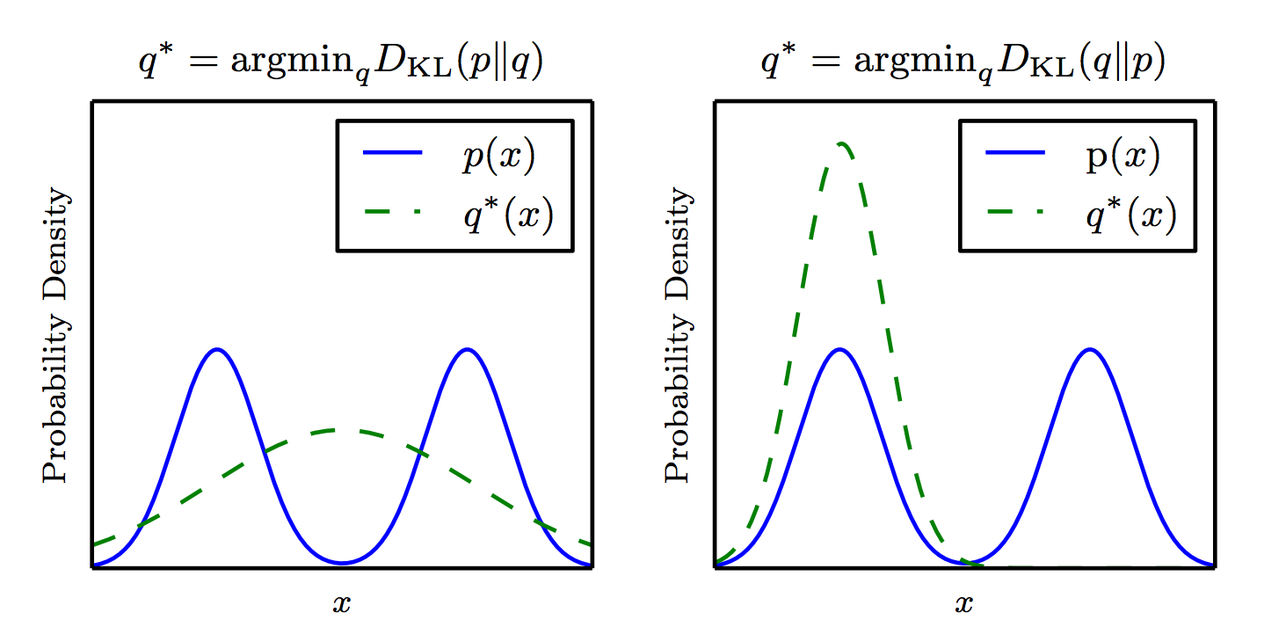

The KL divergence is asymmetric
Figure 3.6
Notes:
1, The KL divergence is zero when the two distributions are the same
2. The KL divergence is not symmetric; and we could make it symmetric
3.(DKL(P||Q) + DKL(Q||P) )/2 is symmetric
The following link gives a very good introduction of how to perform KL divergence in inclusive or exclusive model.
https://timvieira.github.io/blog/post/2014/10/06/kl-divergence-as-an-objective-function/

Slide 48
Optimisation and numerical computation

Slide 49
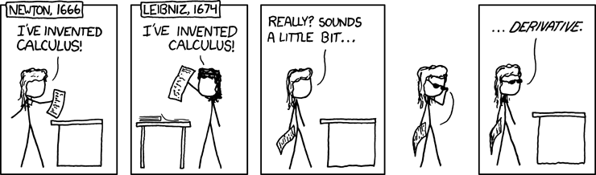

Slide 50

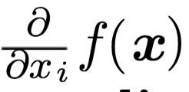
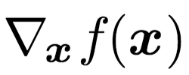
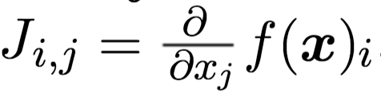
First order derivatives
First order derivatives
Partial derivatives and gradient
Jacobian matrix

Slide 51
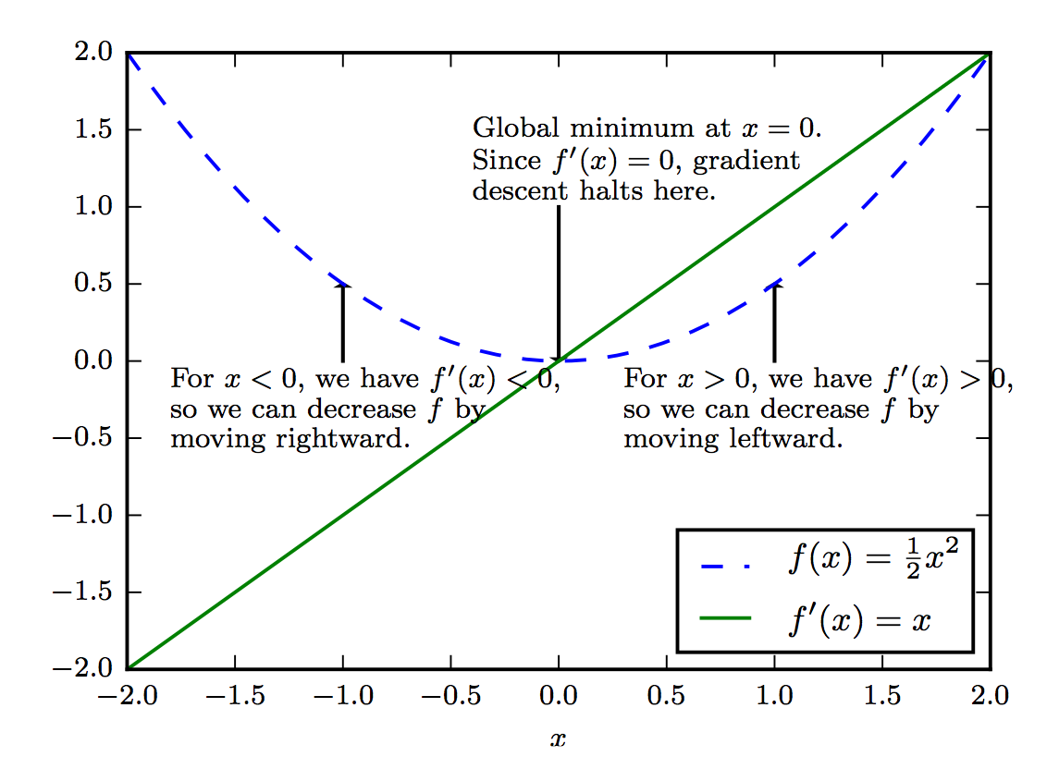
Gradient descent

Slide 52
Gradient descent
If x is multi-dimensional we follow the gradient, i.e., vector of partial derivatives

Slide 53
Gradient descent
See http://www.deeplearningbook.org/contents/numerical.html page 83
Notes:
This quadratic curve/function has a close form solution at its minimum, by setting f’(x) to zero.
But here we used it to illustrate the working principle of gradient descent.

Slide 54
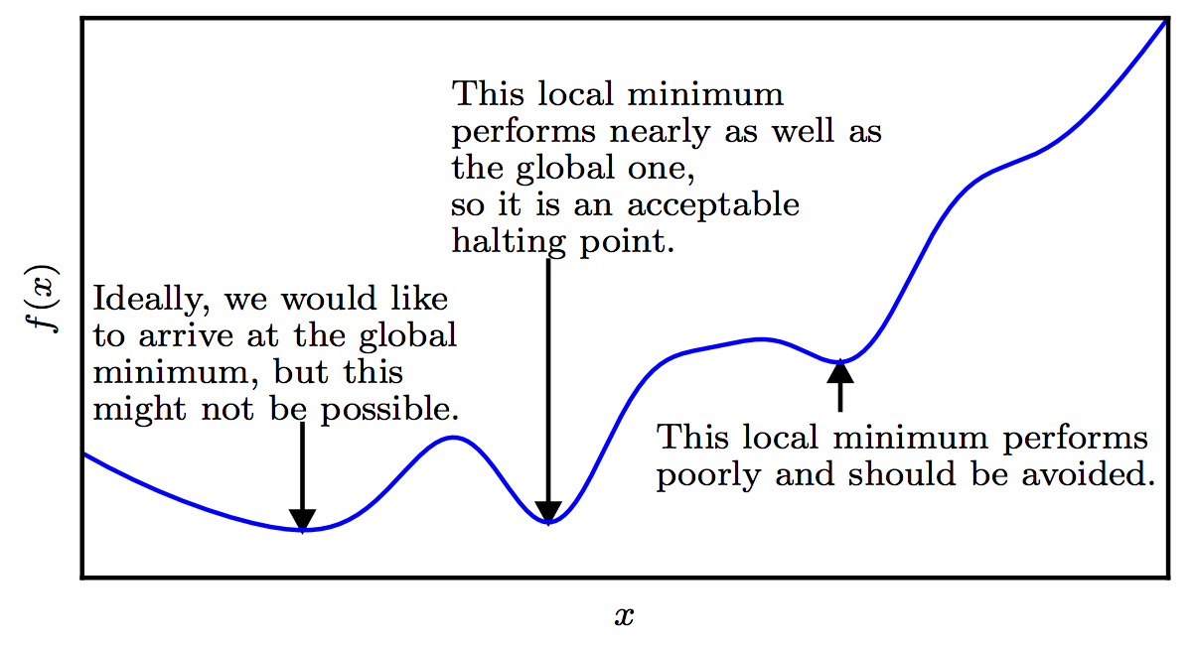
Approximate optimisation
Figure 4.3

Slide 55
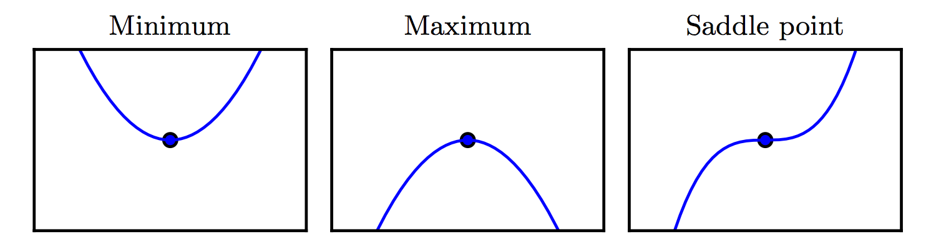

Critical points
Figure 4.2

Slide 56
Optimising in deep learning
Pure math way of life:
Find literally the smallest value of f(x)
Or maybe: find some critical point of f(x) where the value is locally smallest
Deep learning way of life:
Decrease the value of f(x) a lot

Slide 57


Curvature
Figure 4.4

Slide 58


Second order derivatives
Second order derivatives
Hessian

Slide 59
Second order derivatives
Second order derivatives
Hessian
In deep learning usually H is a symmetric real-valued matrix,
thus it can be decomposed in a set of eigenvalues and orthogonal eigenvectors

Slide 60
Optimal step size using Taylor series

Slide 61
Optimal step size using Taylor series
Second order Taylor series approximation of f(x) around x(0)

Slide 62
Optimal step size using Taylor series
Value of the function after gradient descent step

Slide 63
Optimal step size using Taylor series
Value of the function before the step

Slide 64
Optimal step size using Taylor series
Improvement due to slope of function

Slide 65
Optimal step size using Taylor series
Correction due to curvature

Slide 66
Optimal step size using Taylor series
If this is positive, we can look for the optimal step size that minimises the Taylor-series approximation

Slide 67


Optimal step size using Taylor series

Slide 68
Optimal step size using Taylor series
Big gradients speed you up (larger numerator means larger step size)

Slide 69
Optimal step size using Taylor series
Big eigenvalues slow you down if you align with their eigenvectors
(larger denominator means smaller step size)

Slide 70
“Real” issues
Algorithms often specified in terms of real numbers
Can only be implemented with finite number of bits; does the algorithm still work?
Do small changes in the input to a function cause large changes to an output?
Rounding/measurement errors, noise, can cause large changes
Iterative search for best input is difficult
Notes:
Now let us look at some real numerical computation issues in practice. We know that a number will be represented in computer using a finite number of bits. We need to make sure that the implementation actually indeed outputs the results that we want. In this case, we will need to take care of some errors such as the truncation and rounding errors. Those errors could be accumulated through iteration or propagation.

Slide 71
Rounding and truncation errors
In a digital computer, we use float32 or similar schemes to represent real numbers
For a real number x, when we perform x + delta for some small delta, the delta could be potentially truncated off (examples in next slide.)
Overflow: large x replaced by inf
Underflow: small x replaced by 0

Slide 72
Example
Adding a very small number to a larger one may have no effect. This can cause large changes downstream:
>>> a = np.array([0., 1e-8]).astype('float32')
>>> a.argmax()
1
>>> (a + 1).argmax()
0
Notes:
Single Precision Vs. Double Precision
https://www.thecrazyprogrammer.com/2018/04/single-precision-vs-double-precision.html

Slide 73
Secondary effects
Suppose we have code that computes x-y
Suppose x overflows to inf
Suppose y overflows to inf
Then x - y = inf - inf = NaN

Slide 74
exp
exp(x) overflows for large x
Doesn’t need to be very large
Never use large x
exp(x) underflows for very negative x
Possibly not a problem
Possibly catastrophic if exp(x) is a denominator, an argument to a logarithm, etc.

Slide 75
log and sqrt
log(0) = - inf
log(<negative>) is imaginary, usually nan in software
sqrt(0) is 0, but its derivative has a divide by zero
Definitely avoid underflow or round-to-negative in the argument!

Slide 76
log exp
log exp(x) is a common pattern
Should be simplified to x
Avoids:
Overflow in exp
Underflow in exp causing -inf in log

Slide 77
log exp
log exp(x) is a common pattern
Should be simplified to x
Avoids:
Overflow in exp
Underflow in exp causing -inf in log
Also see https://blog.feedly.com/tricks-of-the-trade-logsumexp/

Slide 78
Bug hunting strategies
If you increase your learning rate and the loss gets stuck, you are probably rounding your gradient to zero somewhere: maybe computing cross-entropy using probabilities instead of logits
For correctly implemented loss, too high of learning rate should usually cause explosion

Slide 79
Bug hunting strategies
If you see explosion (NaNs, very large values) immediately suspect:
log
exp
sqrt
division
Always suspect the code that changed most recently

